Slide 1
Nestle Rebranding
ICH-101-05-467

Slide 2
Nestle Brand History
Nestlé is a Swiss transnational food and drink company headquartered in Vevey, Vaud, Switzerland.
It is the largest food company in the world, measured by revenues and other metrics, since 2014
Nestlé's origins date back to the 1860s
In the 1980s, Nestlé’ acquired Carnation for $3 billion in 1984 and brought the evaporated milk brand, as well as Coffee-Mate and Friskies
The confectionery company Rowntree Mackintosh was acquired in 1988 for $4.5 billion, which brought brands such as Kit Kat, Smarties, and Aero.
Since 2010, Nestle has been working to transform itself into a nutrition, health and wellness company.

Slide 3
Advantages
Covers multiple products
Products high in demand
Festive in nature
Versatile

Slide 4
Disadvantages
Confectionary market in decline
Controversies related to health
Competition from rival brands
Quality control

Slide 9
Rebranding
Original logo featured bird’s nest
Bird nest → bird house
Nestle is used in households, gives the feeling of being at home
Childhood nostalgia for home
Gives an image of being organic and close to nature
The N letter inside the birdhouse = Nestle is always featured in your home
The heart at the bottom = Nestle cares for you and your home

Slide 10
#025E9F, C:95% M:66% Y:9%, R: 2 G: 94 B:159
#4DB748, C:71% M:0% Y:100%, R: 77 G: 183 B:72
#7A4D1E, C:37% M:66% Y:100%, R: 122 G: 77 B:30

Slide 11
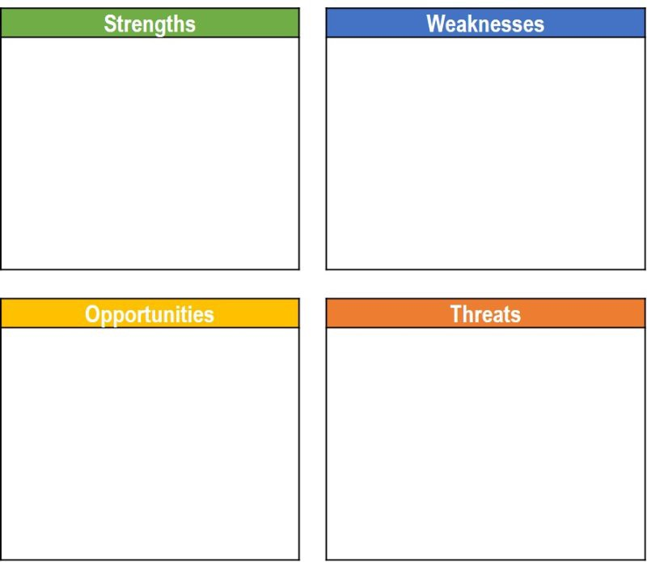
SWOT ANALYSIS
R&D Capability
Strong geographic presence
Unrivalled product and brand portfolio
Environmental sustainability efforts
Recognisability
Criticism over unethical practices
Contaminated food recalls
Clear and accurate labelling
Transparency in material sourcing
Silicon Valley based food startups
Ready to drink tea and coffee
Poor quality water and its scarcity
Increased competition in the beverage and food industries
The price of coffee beans could significantly rise due to major weather disasters

Slide 12
STATIONARY (BUSINESS CARD, LETTERHEAD, ENVELOPE)

Slide 13
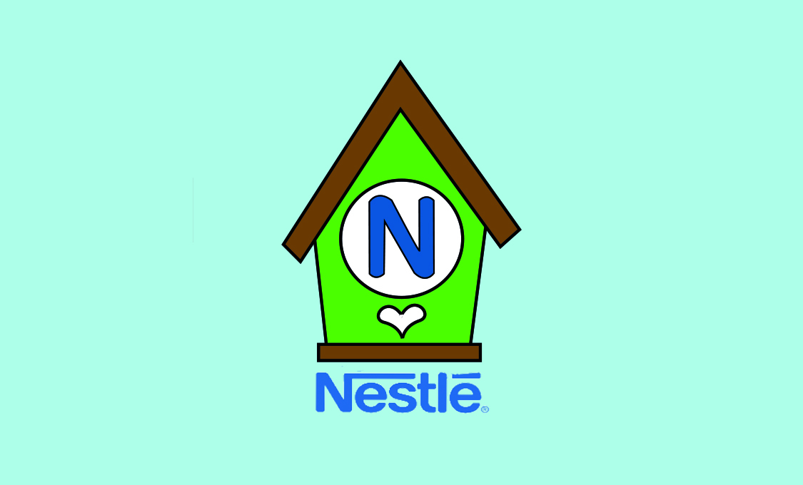
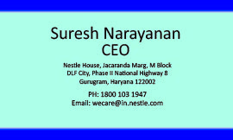

Slide 14
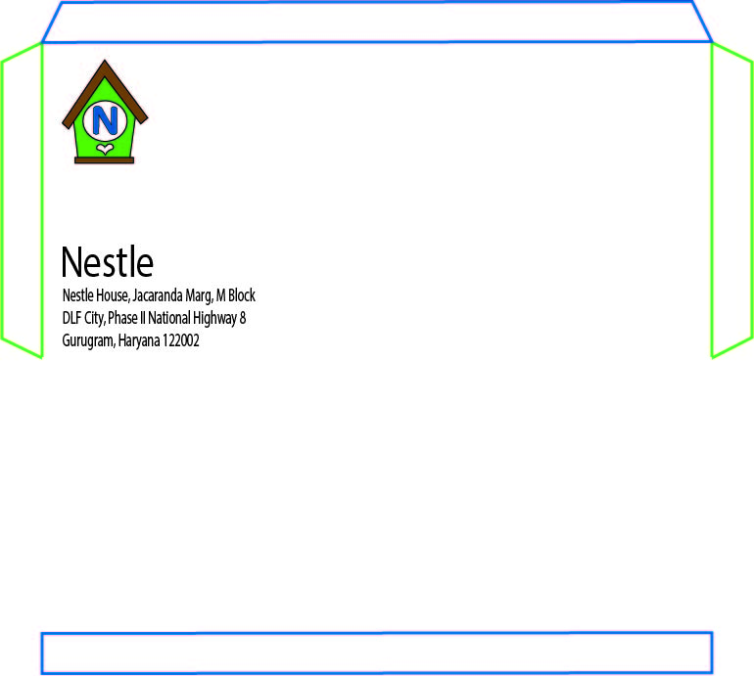

Slide 15


Slide 16
BRANDING (TSHIRT, CAP, PACKAGE, BAG)

Slide 17
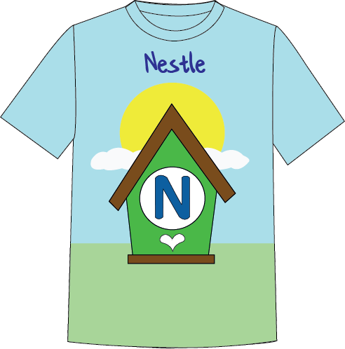

Slide 18
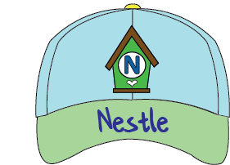

Slide 19
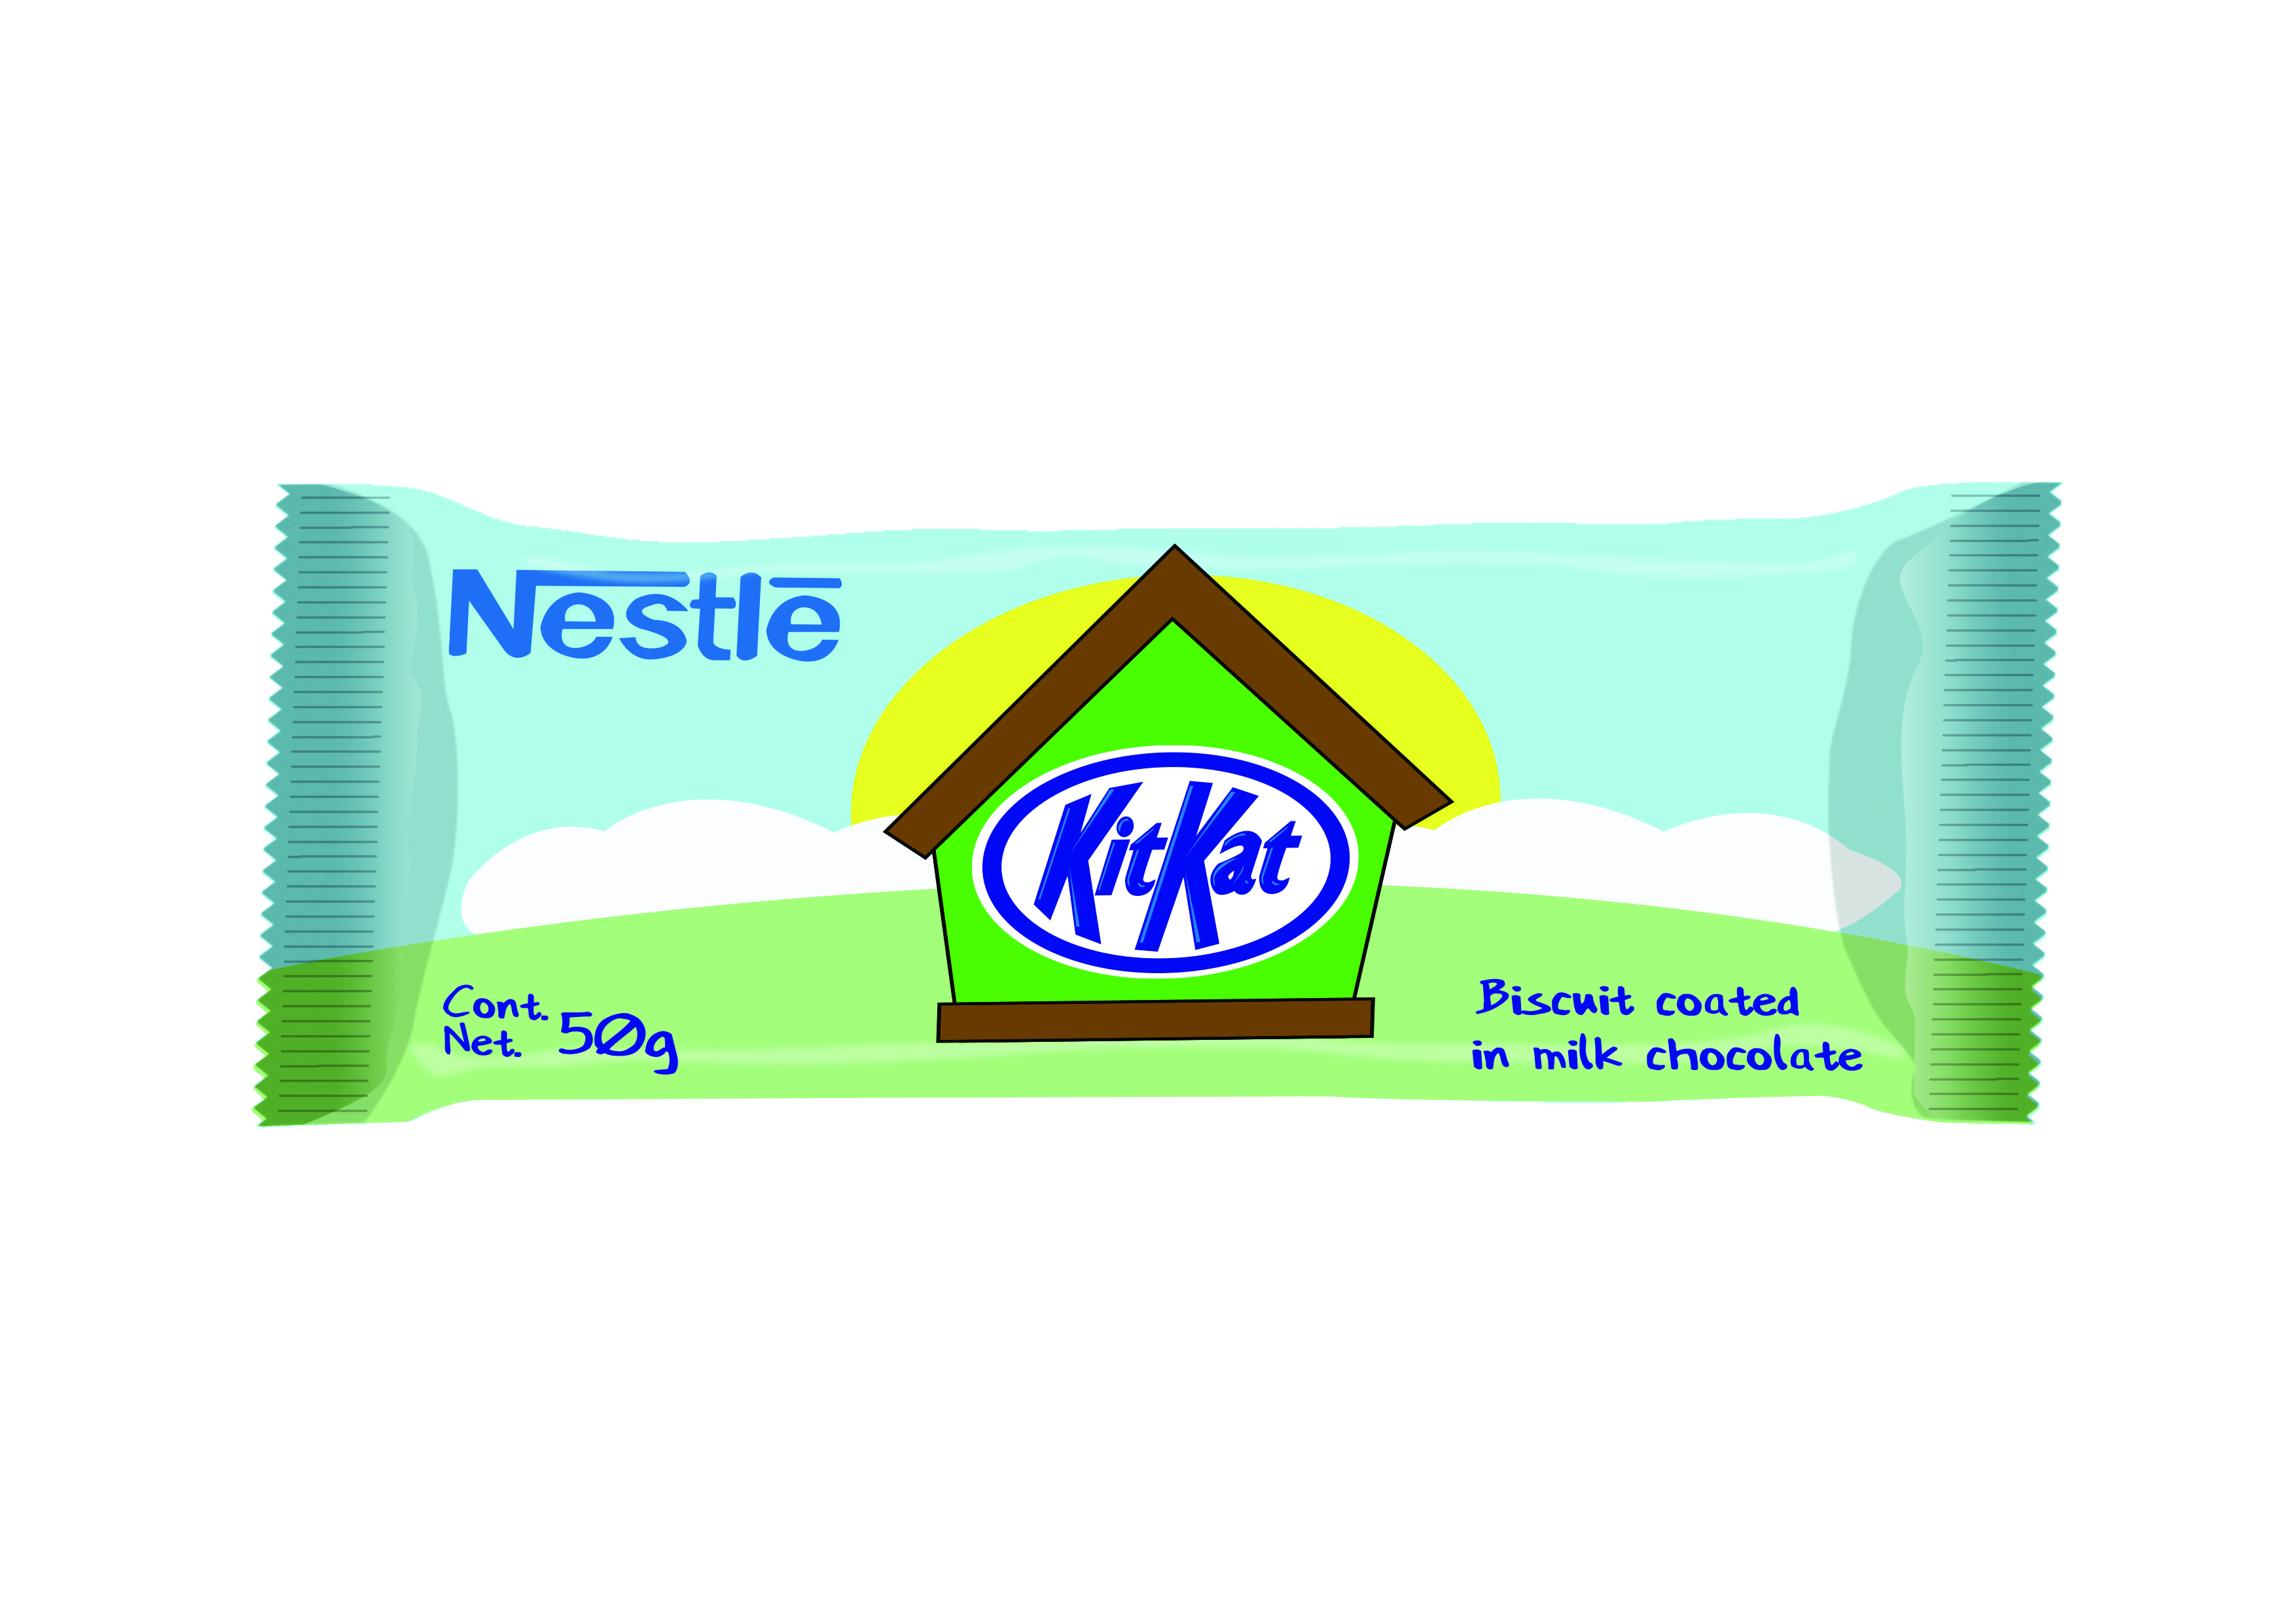

Slide 20
MARKETING (POSTER, BANNER, HOARDING, BILBOARD, TRUCK ADVERT)

Slide 21
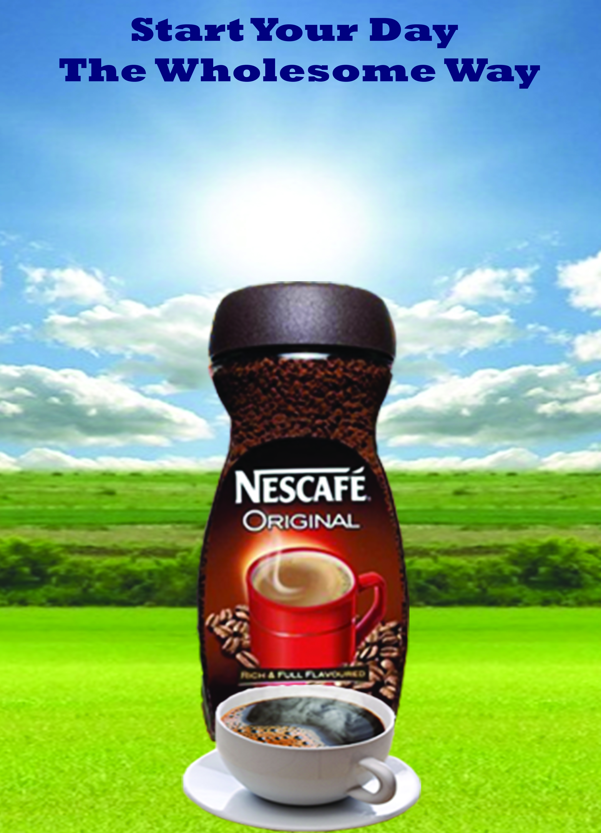

Slide 22
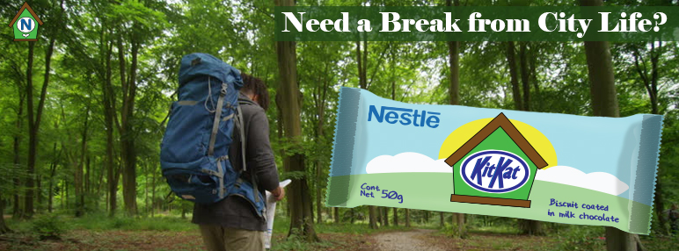

Slide 23
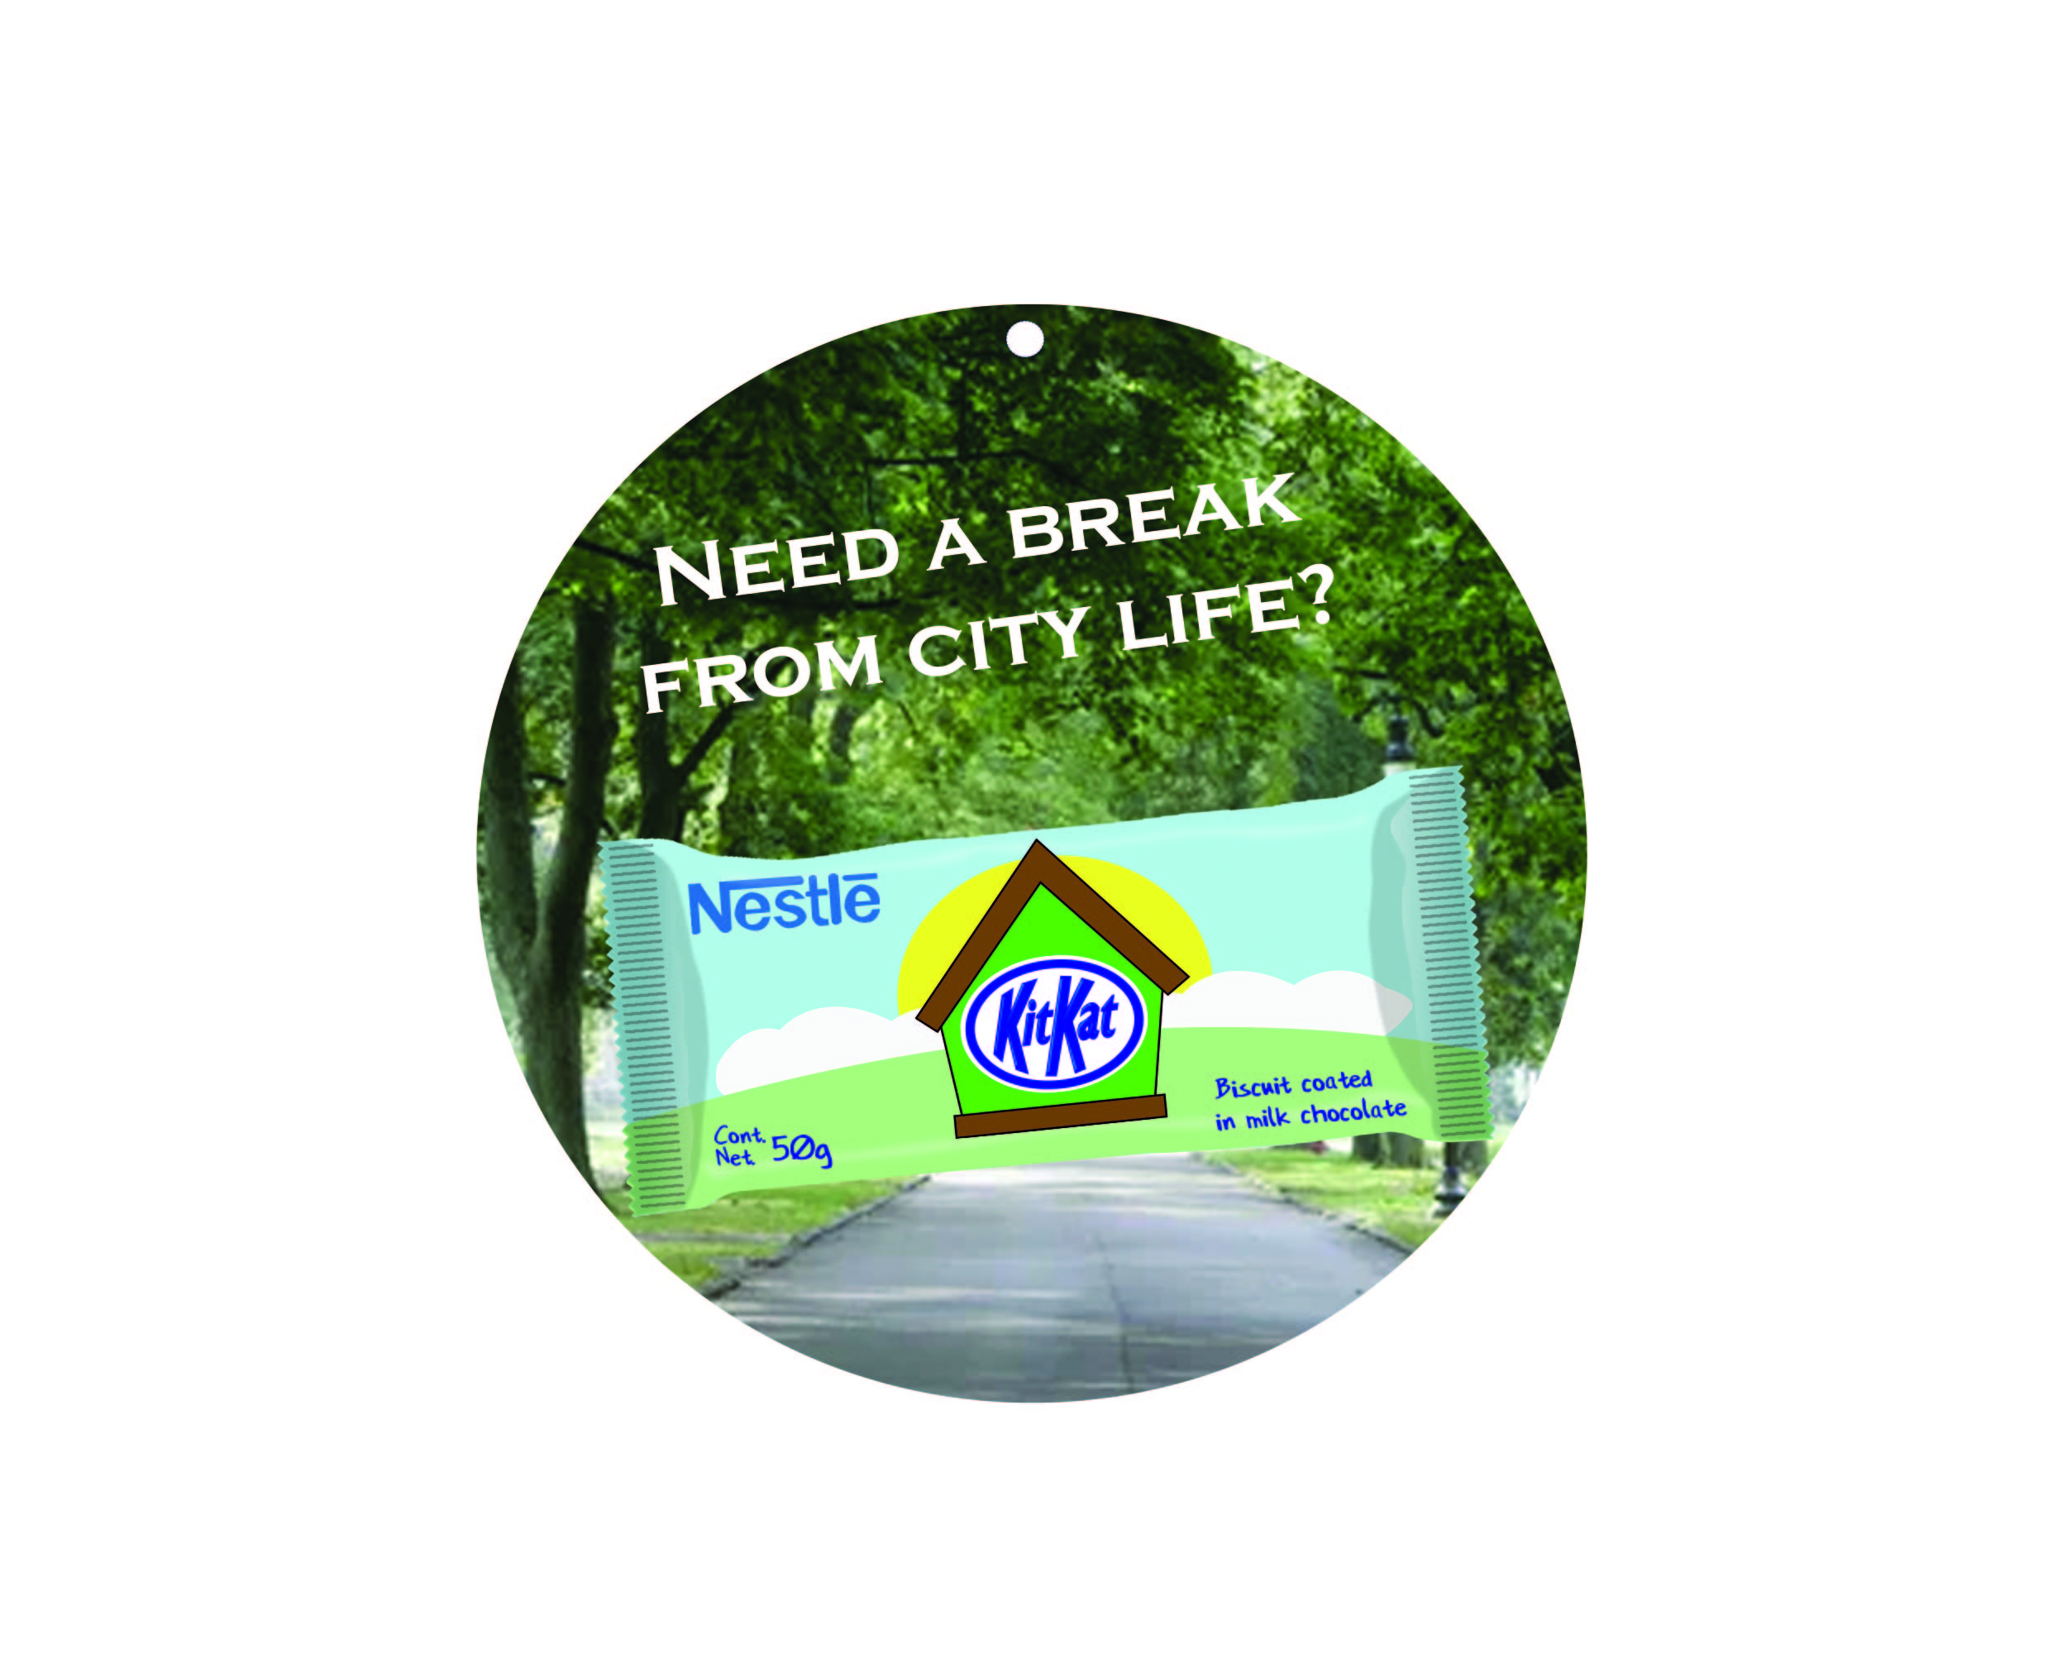

Slide 24
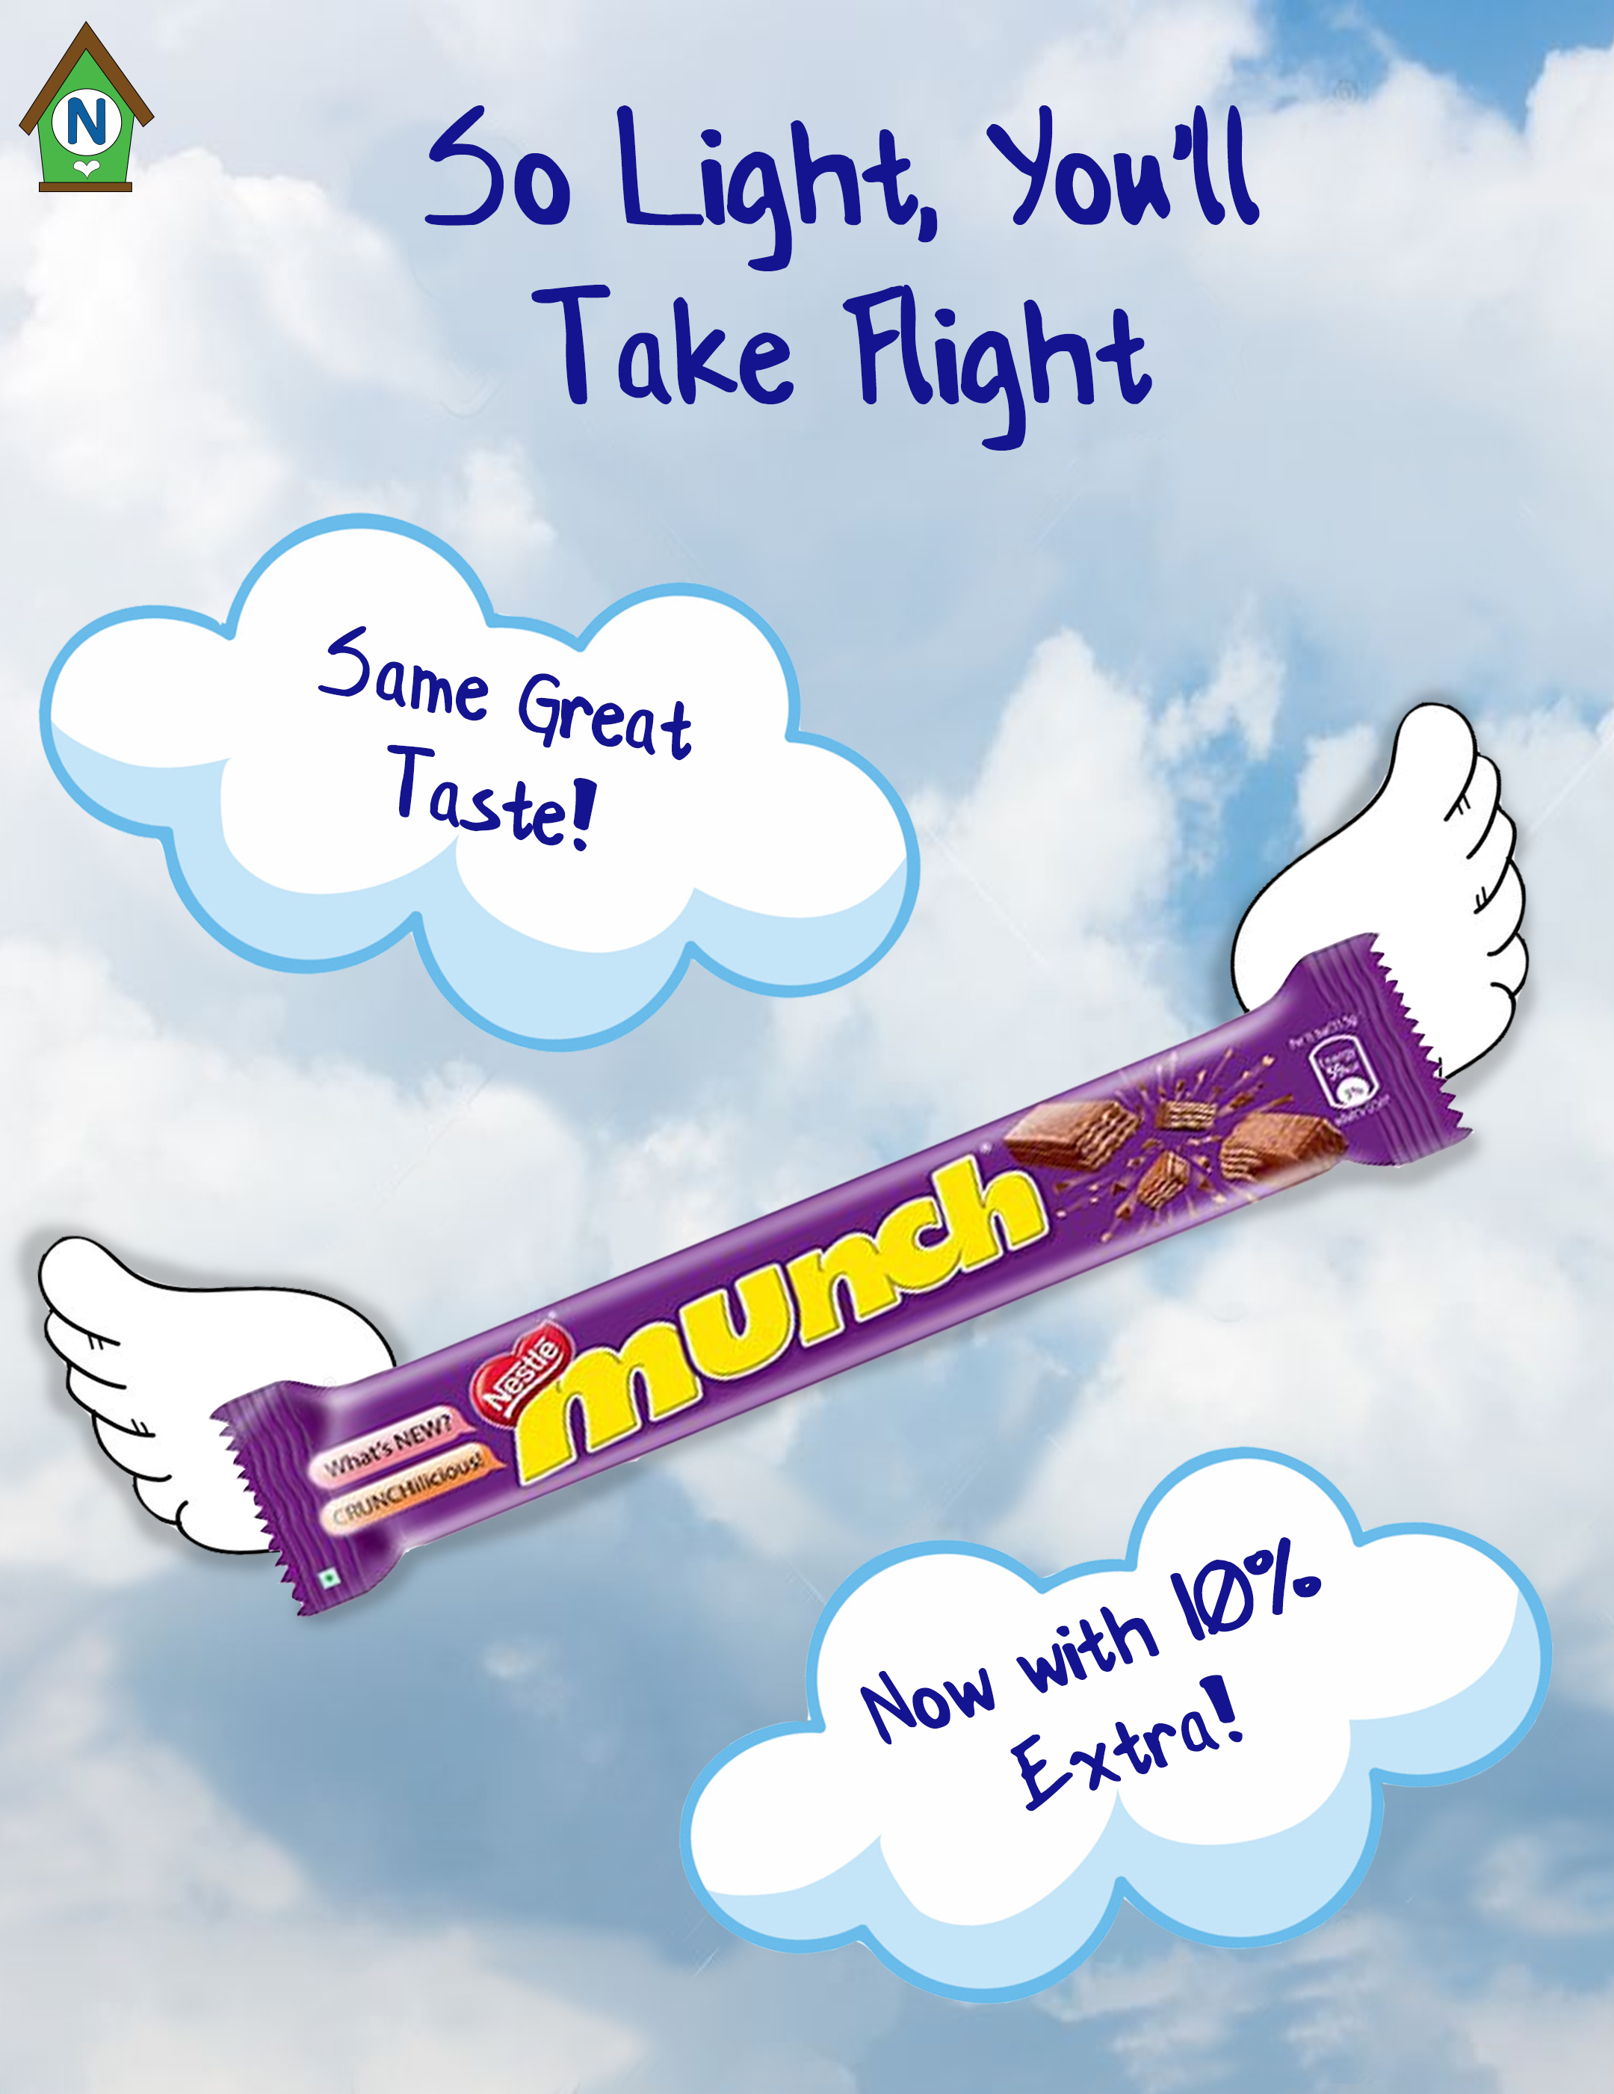

Slide 25
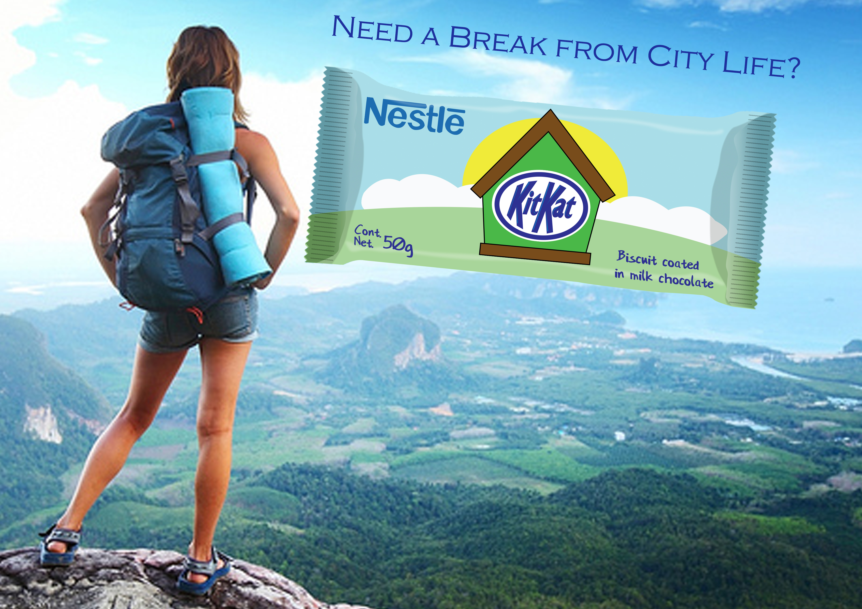

Slide 26
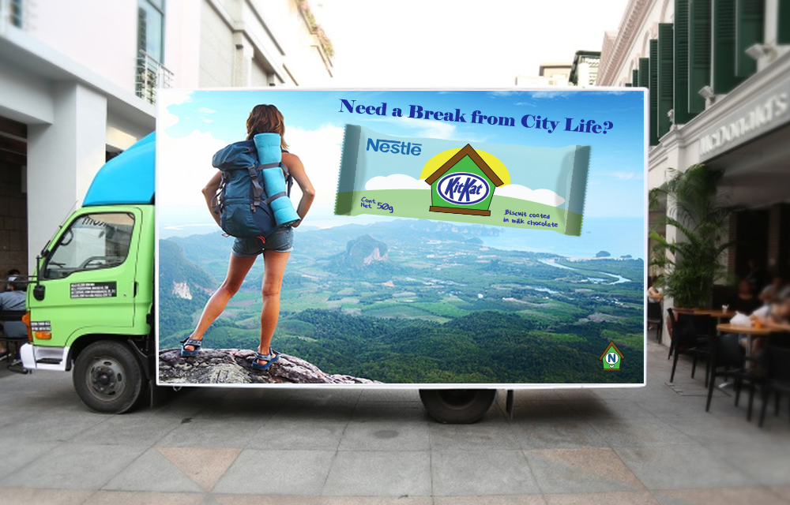

Slide 27
RECIPE BOOKS

Slide 28
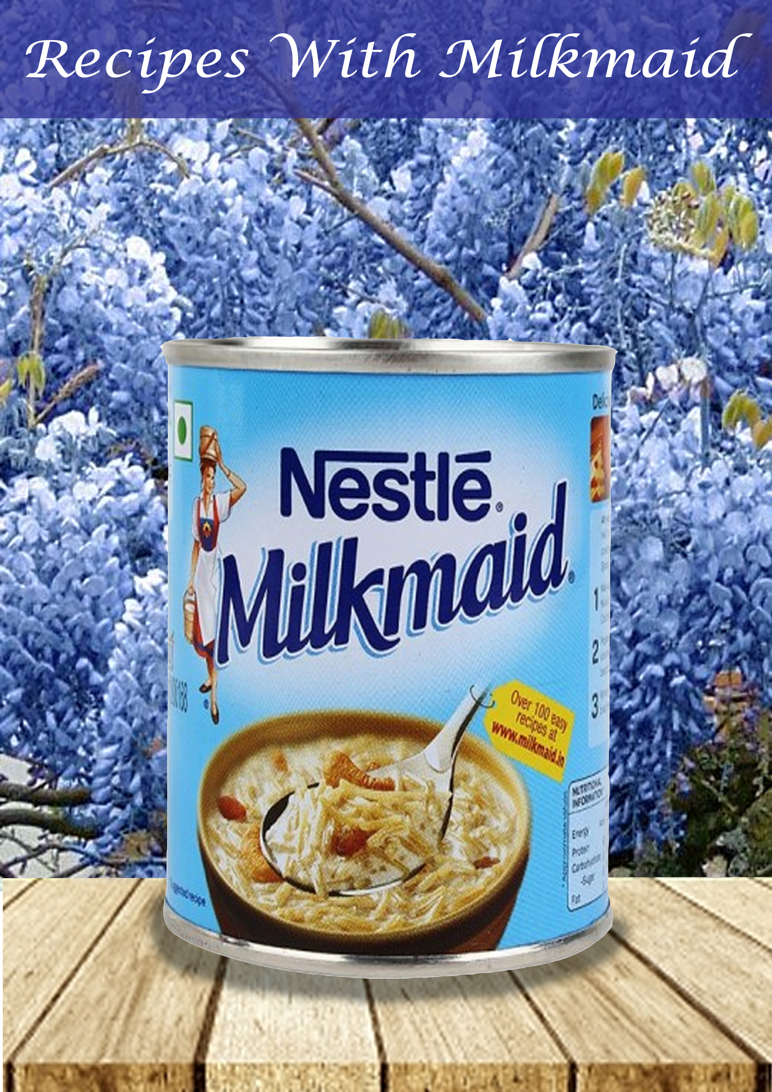

Slide 29
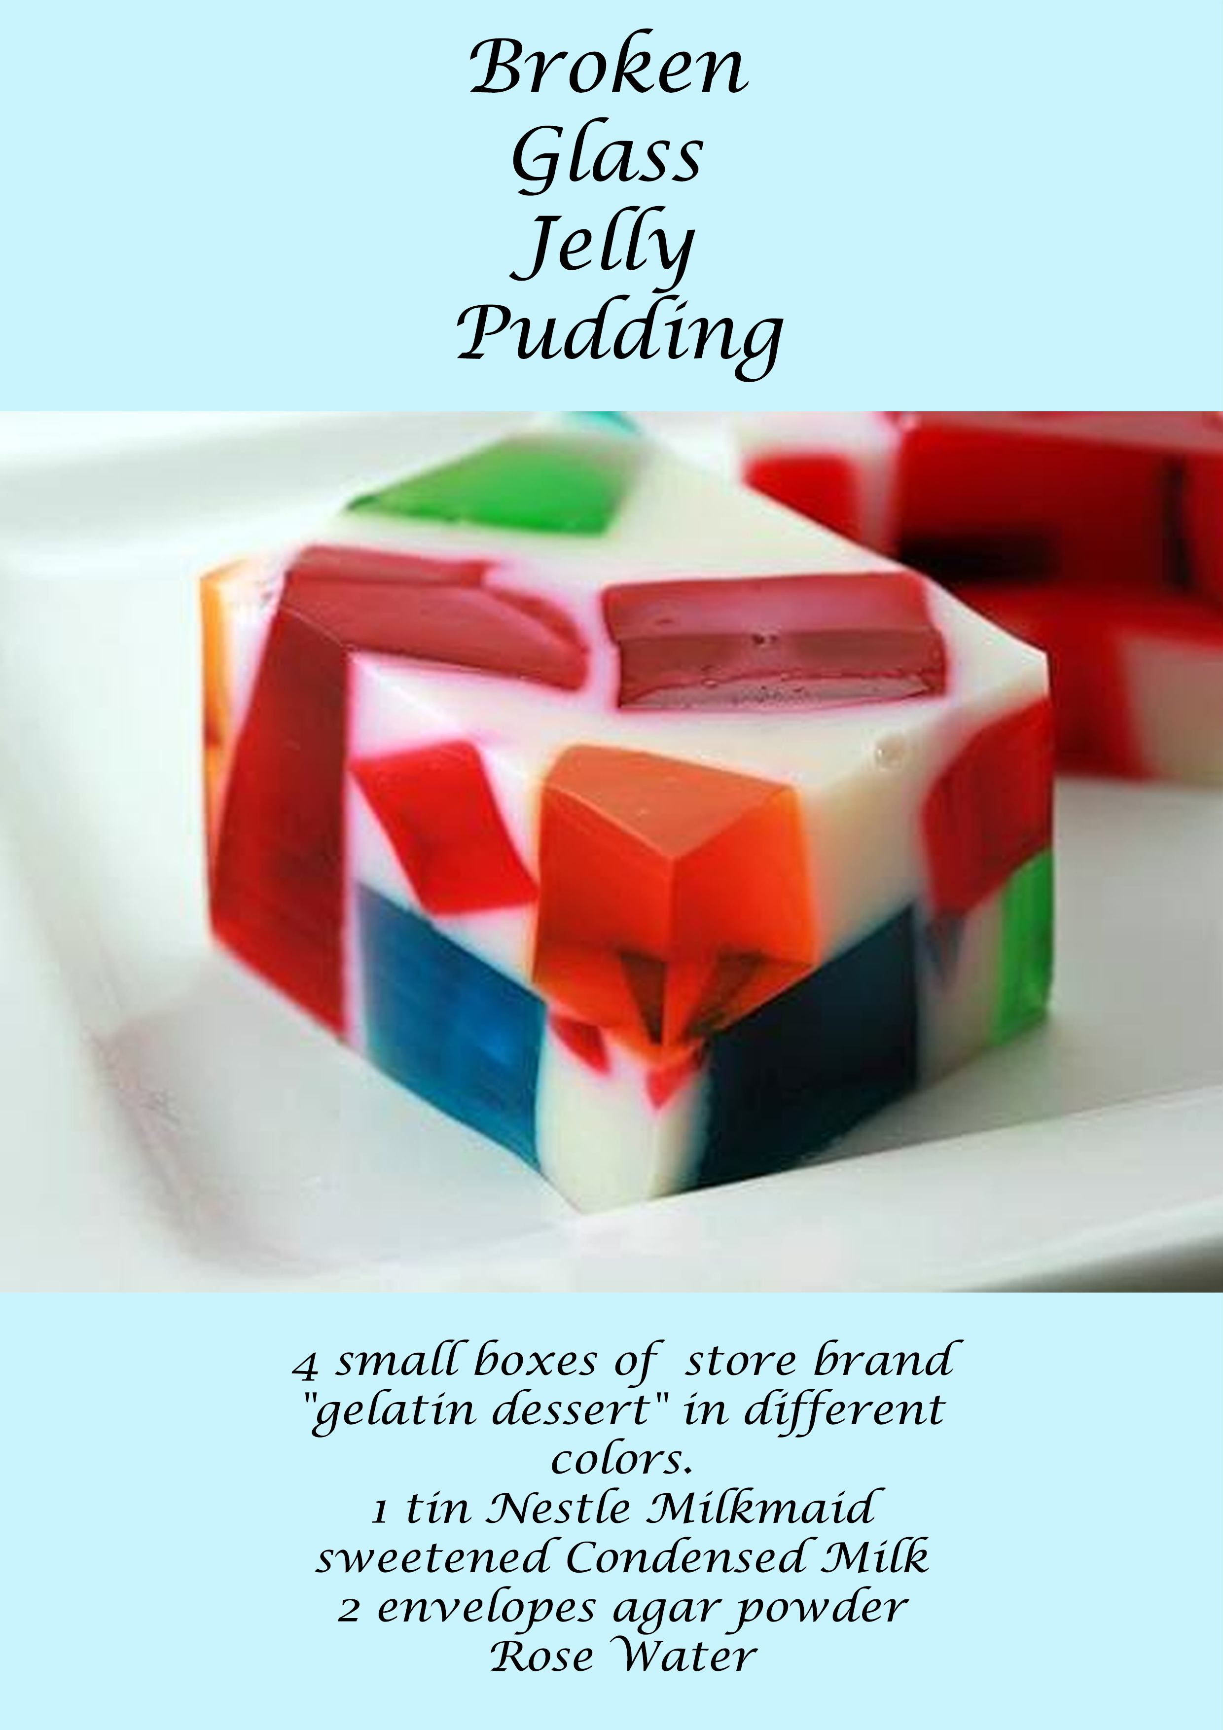

Slide 30
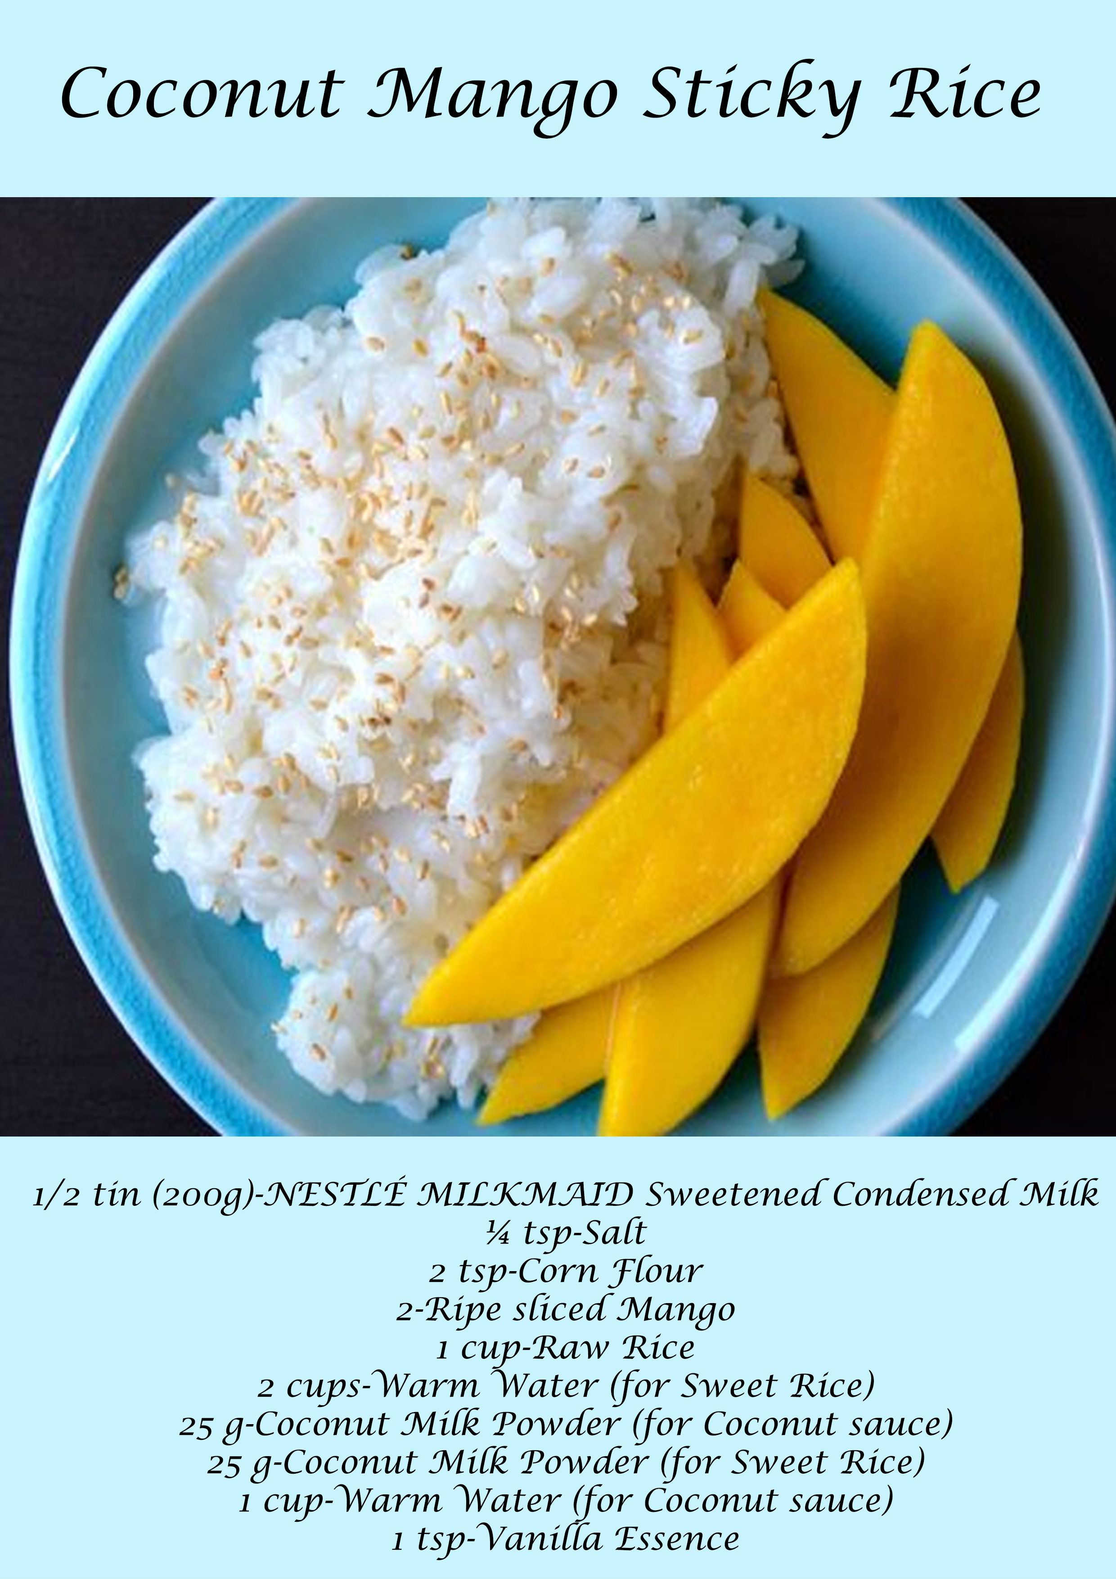

Slide 31
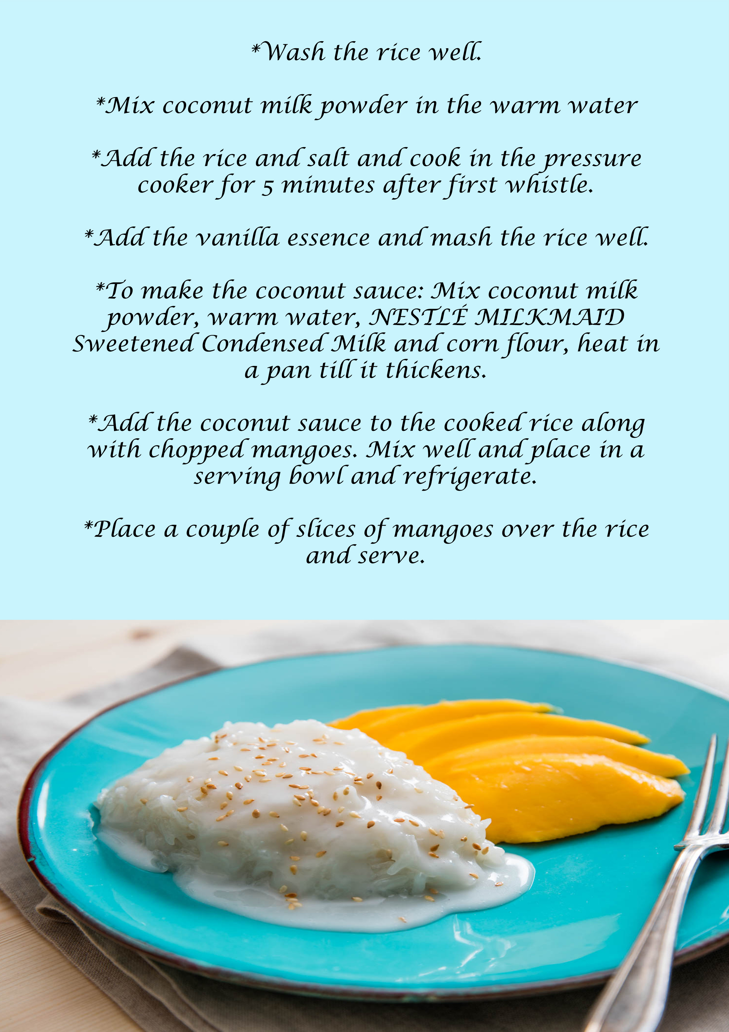

Slide 32
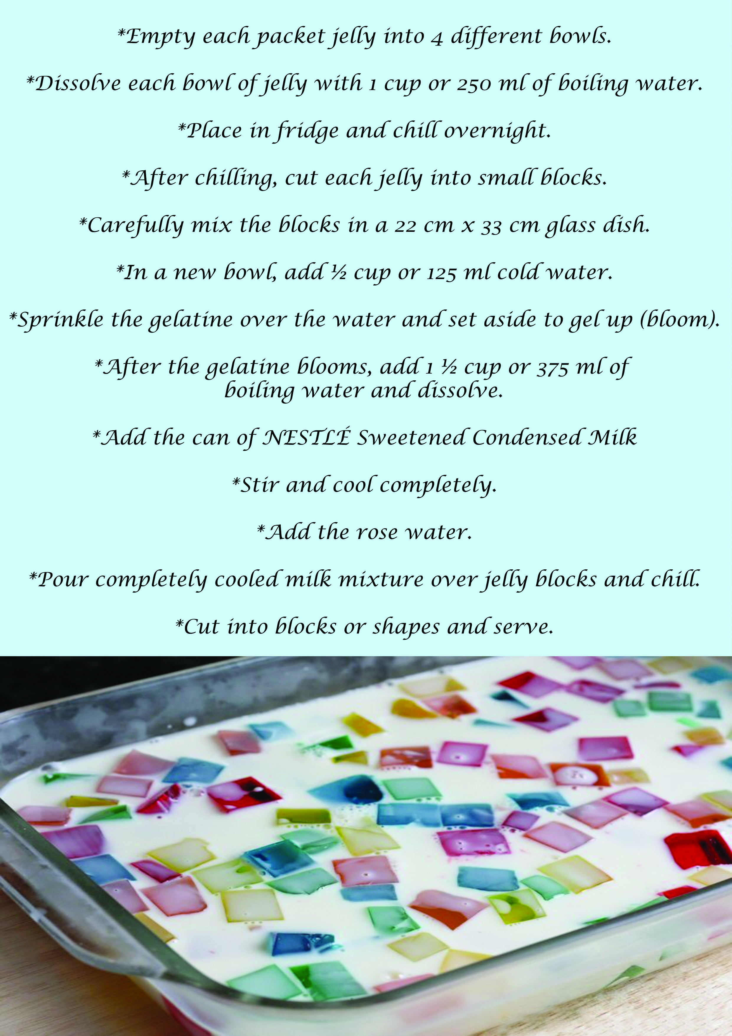

Slide 33
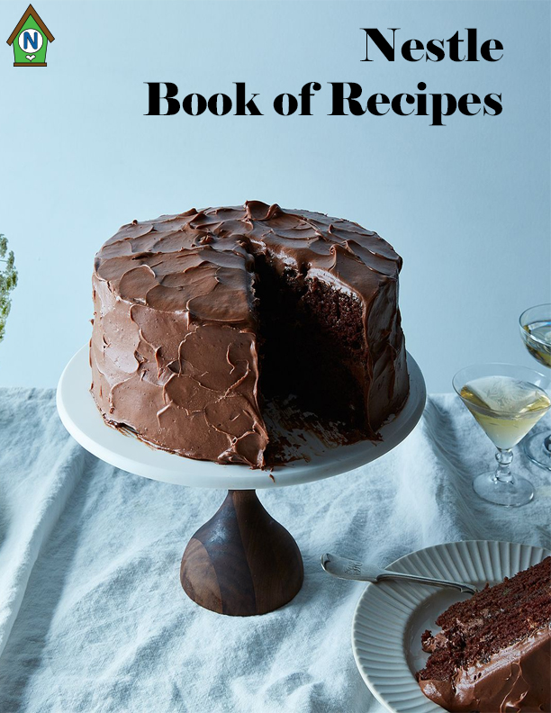

Slide 34
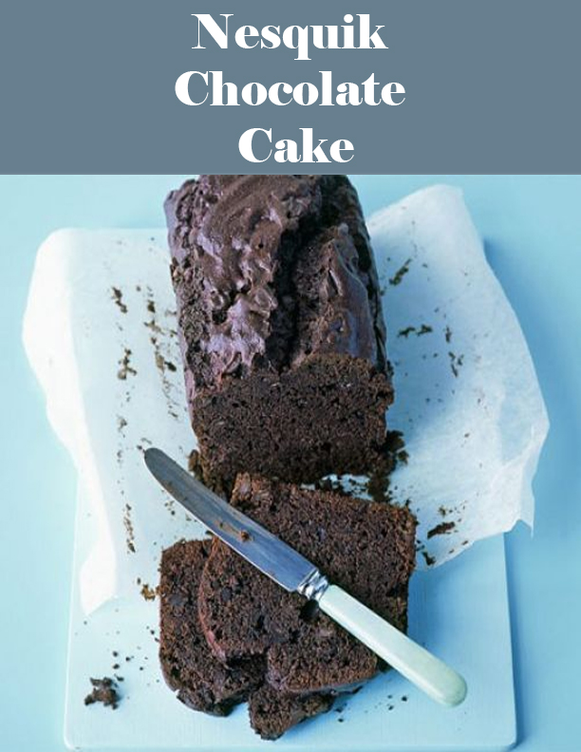

Slide 35
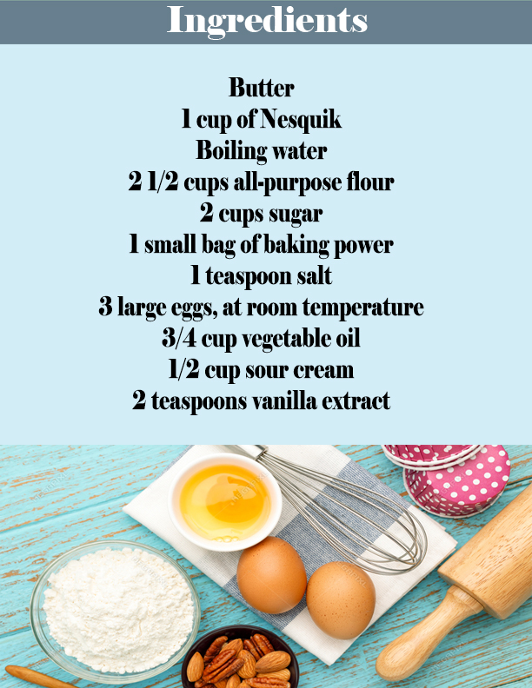

Slide 36
